Slide 1


Powering The Internet Of Food To Connect and Personalize The Network Of Food
Services Platform Case Study – Under Construction
MIT IDE Platform Strategy Summit
July 10, 2015
Jerry Wolfe, Vivanda CEO and Founder

Slide 2
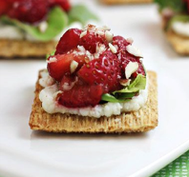

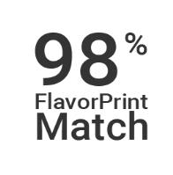
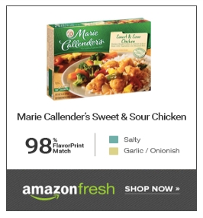
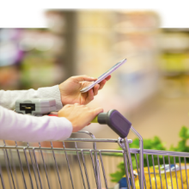
The Personal and Trusted Food Advisor Connecting the
Network of Food to Meet Consumer Needs
Consumers are making choices when meeting their personal food needs, and the primary driver for choice is always taste. In this decision making process they are spending $1.5T on food in the US annually. They are dissatisfied with this essential need being meet by the “Network Of Food”. With 10’s Billions ($) in untargeted, inefficient and ineffective spending to influence food choice, the stage is set for disruption of the entire industry.

Slide 3
The Problem – The Network of Food Has Become Dysfunctional (One Might Say Broken)
…76% of consumers claim to be bored with their food
$15 billion lost per year with untargeted, inefficient and increasingly ineffective tactics to activate food
59% of consumers want personalization when grocery shopping
76 % of global consumers are willing to pay more for foods that promote health benefits
Grocers carry about 35,000 items
Average US household prepares
9 meals over and over again
Only 5% of marketing dollars are spent in a truly targeted way
Less than 3% of the more than 20,000 new products launched every year succeed
50% purchases influenced by at least one digital touch point
60% of meals are prepared at home
Grocery shopping planning is an extremely fragmented and complex process
Manufacturers are losing $0.30 per $1 spend of the estimated $52 billion of trade spend
Too many recipes, too many places, and too much information…
Customers use only 0.8% of the food items available to them
…Manufacturer and Retailer revenue and profitability growth is tepid
IRI believes that chances of a product being purchased are 80% once on a grocery list

Slide 4
The Network of Food
Market Size based on U.S. Figures
$1.7T
$52B+
Negative $0.30 per $1 spent…
14B
Shopping Trips per Year
4.5x
Eating Out per Week
Billions
Social Posts
…out of majority of dollars spent.
Consumers spend a significant amount of money on Food annually …
… with Brand Marketers spending Billions on Trade and Consumer Advertising
… and a large scale number of touch points are accessible digitally to influence consumer choice throughout The Network of Food.
Notes:
The State of American Dining in 2015
By Zagat Staff | January 20, 2015
Eating Out
We asked surveyors how many times a week they go out to eat (not counting breakfast) and ended up with a national average of 4.5 times per week. At the high end, Atlanta surveyors eat out the most frequently (5.2 times per week), while the country’s least frequent diners live in Portland, OR, and Minneapolis (both at 3.4 times per week).
Cost of Dining Out
|New York City has a reputation as an expensive town, and the results of our survey confirm that impression. New York City surveyors reported spending an average of $48.15 for dinner out, $8.75 over the national average of $39.40.
On the other end of the spectrum, if you’re interested in eating cheaply, head to Texas: the two least expensive U.S. dining cities in our survey are Austin ($25.81) and Dallas/Fort Worth ($30.34).

Slide 5
The Emergence of the Connected Consumer Signals The Tipping Point For Behaviors Driving the Network of Food
CPG manufacturer and retailers are struggling with unprecedented levels with growth and declining effectiveness of historical advertising and promotional practices to influence choice and drive growth.
“…the leaders in our industry kept coming back to three key words to describe the future food retail experience: personal, digital and virtual.”
FMI president and CEO Leslie G. Sarasin
Shifting demographics and the adoption of connected behaviors have changed the Network of Food
creating a…
…growth opportunity to meet significant unmet consumer needs associated with food choice…
…driven by taste, value and health/wellness by using multiple digital tools…
>50% CPG sales digitally influenced
CPG eCommece accounting for majority of CPG growth
Massive levels of investment flowing into food tech

Slide 6
Taste Is The Primary Driver Of Food Choice
Our Product – FlavorPrint Services…Powering The Network Of Food
The Business Value of FlavorPrint
Businesses win by connecting efficient and effective activation of food purchases
Creating a new standard for the identification of the taste and texture by printing products and people
Delivering personalized and contextualized recommendations and food experiences via API enabled platform
Providing data, insights and analytics to partners for better understanding of consumer interactions with food
FlavorPrint Services enables the Network of Food to meet the consumers needs and generate profitable growth.

Slide 7
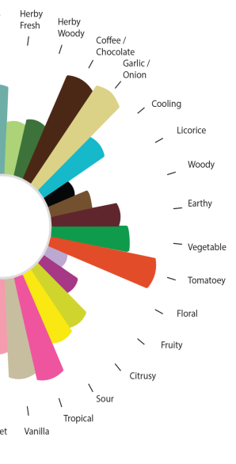


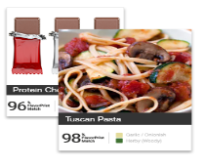
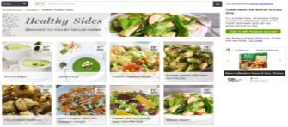




FlavorPrint Services - Personal Food Advisor Service Platform
  By mapping 16,000 Aroma Chemicals to 33 Flavors and 17 Textures along with dietary and nutrition attributes we create a unique flavor and texture “FlavorPrint” fingerprint for any food and beverage item.
  From the automated analysis of a diverse set customer interaction data we develop and assign a unique and personal “FlavorPrint” fingerprint for the every individual.
  The consumer uses FlavorPrint to understand his personal compatibility to food and beverage items and gets contextualized recommendations for products, recipes, menu items, coupons, shopping list items and more.
  By implementing FlavorPrint into any digital experience via FlavorPrint API plug-in, the user’s profile becomes portable along with personal and contextual recommendations, with channel partners throughout The Network Of Food.
  We are collecting massive amounts of evolving food and flavor data and provide our partners with insights into behaviors, trends, and opportunities to address unmet customer needs.
  The result for Network of Food is profitable growth through efficient activation of the connected consumer.
1.
2.
3.
4.
Link experience data and/or take our easy quiz about your taste preferences…
That makes up your personal FlavorPrint…
And helps you discover the products and recipes you’ll love…
Throughout the Network Of Food

Slide 8
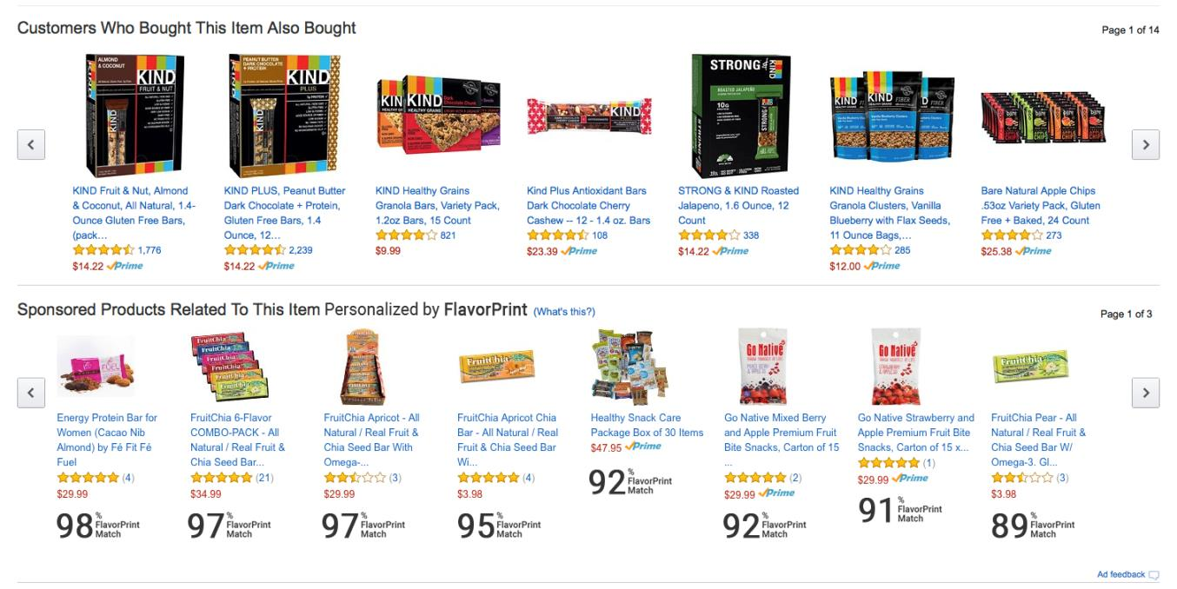
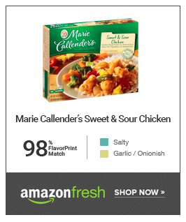
FlavorPrint for Products

Slide 9
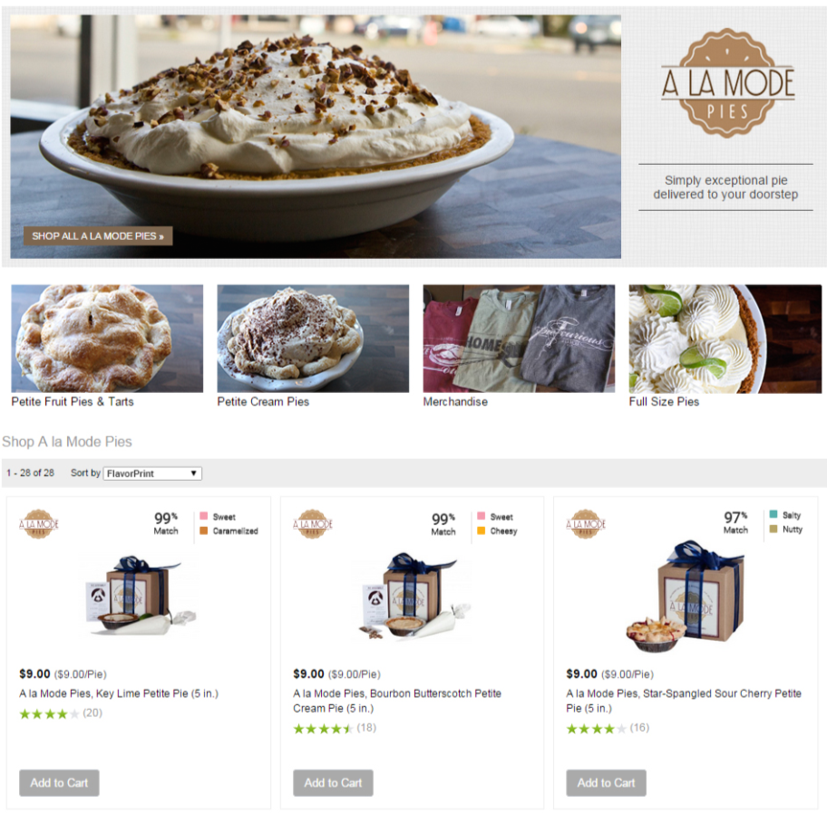
FlavorPrint for Local Shops & Restaurants
Vivanda can FlavorPrint local restaurant menus as required

Slide 10
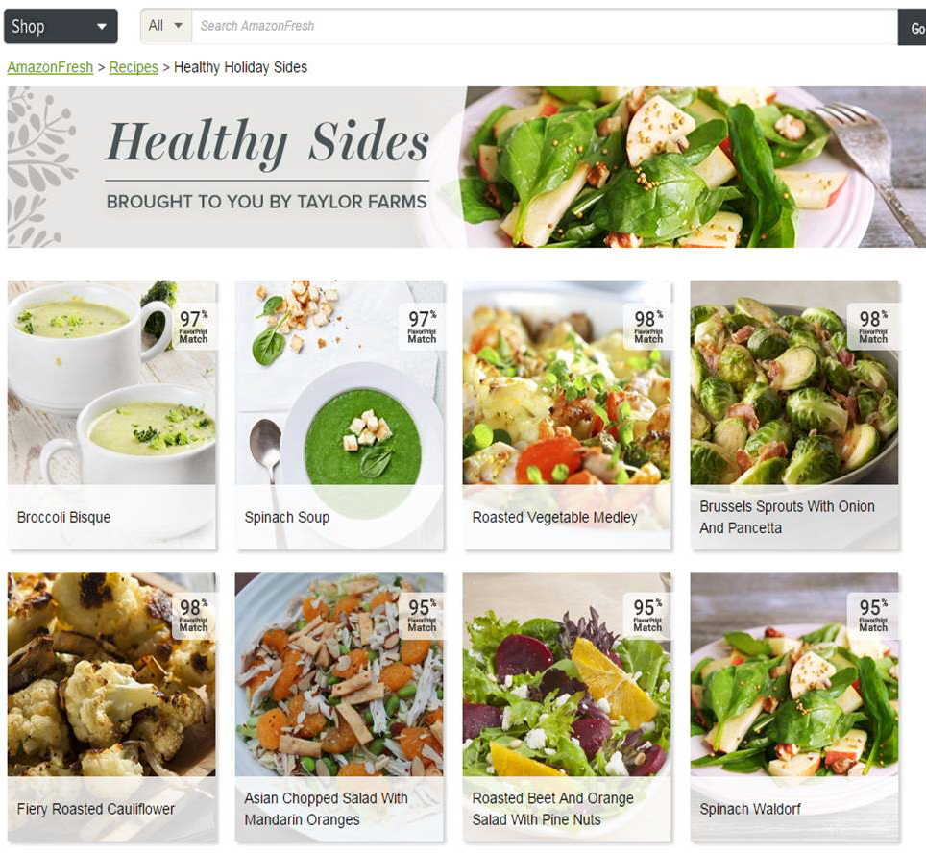
FlavorPrint for Recipes

Slide 11
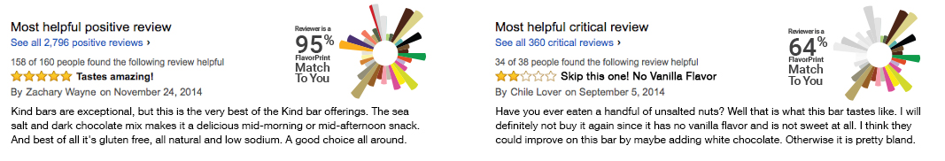
FlavorPrint for Comparing People

Slide 12
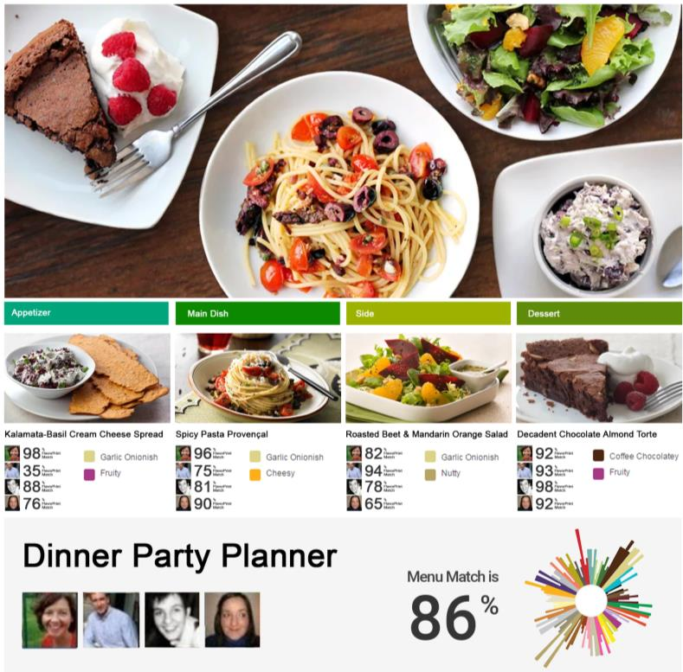
FlavorPrint for Party Planning
Innovative Services To Capture Trip Missions – Special Occasion Example

Slide 13
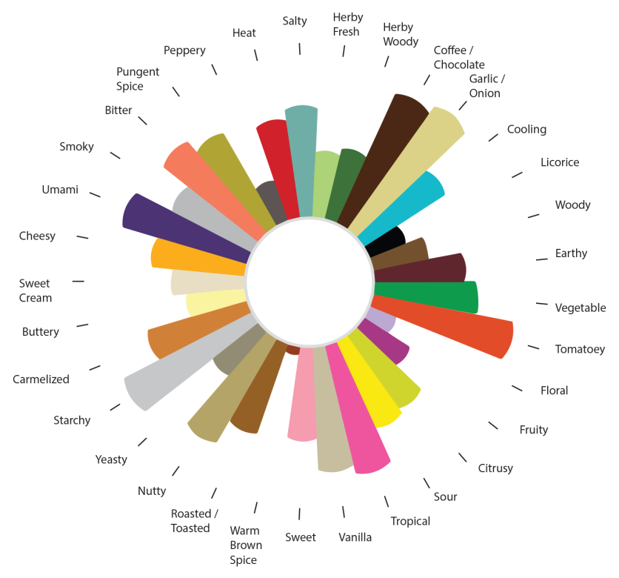
Vivanda Data and Analytics
FlavorPrint provides a revolutionary new way to understand people and the products they buy through the lens of Flavor and Texture.
New Perspectives To Enable:
Category and store assortment and merchandising
Targeting offers and promotions
Development of new products and services
Mashups with existing data sets of syndicated, loyalty and web behavior

Slide 14
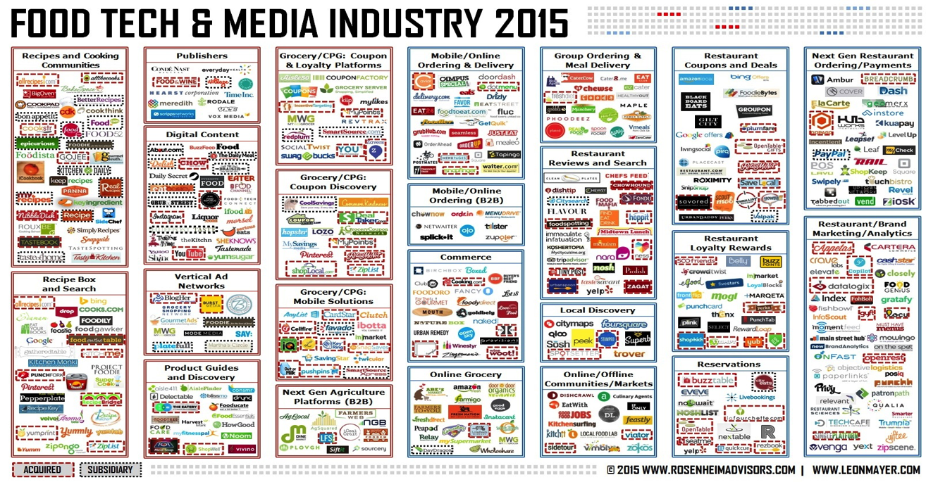











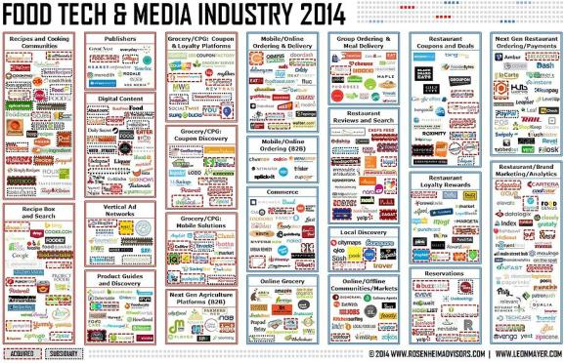




FlavorPrint Personalization Services Creating Value For The Network of Food
Brands With
Food Interests
Life Sciences
Brands FlavorPrint product portfolios and derive insight from the new ways of exploring data for actionable insight.
Food
Brands
Publishers
Publishers use personalization to increase usage and actionable recommendations. Which leads to increased customer spend.
Food
Retailers
+
FlavorPrint data and consumer Interactions are collected and analyzed by Vivanda and provided to the ecosystem as a service to promote growth strategy..
Consumers
Brands work with Channel Partners to participate in the personalization programs.
Brands and Channel Partners access efficient growth opportunities with consumers and increase loyalty.
Restaurants
Vivanda compliments and enhances most Food Tech offerings and enables the Internet Of Food.
Notes:
Points of Distribution

Slide 15



FlavorPrint® Users are More Engaged…And They Buy More
Engagement rates have maintained their significantly high levels as registrations have increased!
FlavorPrint® users save 13X more recipes vs. old site
FlavorPrint® users buy more and have larger baskets
Average Visit Duration | % Return Visits | Pages/Visit | Bounce Rate
Additional 17+ minutes | 2x higher | 6x higher | 21x lower
34%
11.21
69%
19:18 mins.
14%
1:39 mins.
1.89
3%
Low bounce rate is positive
Imagine The Impact Of This Engagement Across The Network Of Food
*FlavorPrint® Database
McCormick users include registered and non-registered users
Google Analytics March 4, 2013 – March 3, 2014, Users from 04/18/2014

Slide 16

Translating the Results Experienced By MKC Into Results Experienced By Customers and Channel Partners
The result is a dramatic increases in various user engagement metrics, consumer satisfaction and influence on incremental purchase.

Slide 17







How FlavorPrint Was Developed
With Exclusive Access To 125 Years of McCormick’s Culinary Know-How and 30 Years of Food Science…
Over a billion dollars of investment
A Food and Flavor Genome
Machine learning algorithms based on contextual interactions with food and matching recommendations of food items.
FlavorPrint as a service was deployed via API and tested on mccormick.com
  First industry standard for the intuitive visualization of the flavor palette.
The design and patented functionality is built on a combination of proprietary and market leading technology, such as…

Slide 18
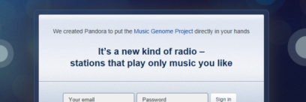


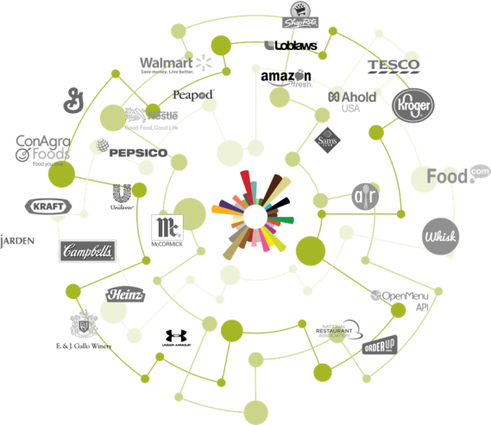

The FlavorPrint Opportunity
Connecting our Omni-Channel Partners with Consumers Throughout the Network of Food
What Pandora did for Music…
…and what ApplePay is doing to disrupt payment…
Your wallet.
Without the wallet.
FlavorPrint is doing for Food.
FlavorPrint is doing for The Network of Food.

