Slide 1
What Can Incumbents Learn From Leading Platforms?
Case for A Cognitive Decision Management Platform
Sanjiv Sidhu
Founder and Chairman
o9 Solutions, Inc.

Slide 2

Complexity and speed of business is growing exponentially
Increasing personalization
(Amazon, Netflix)
Shortening product innovation cycles
(Apple, Samsung, Frito Lay)
Growing multi-channel sales complexity
(Frito Lay)
Growing non-traditional supply sources
(Invisalign)
Arrival of IoT
(Uber, Google Maps)
Growing non-traditional competition
(Airbnb)

Slide 3
Requiring ever growing number of decisions to be MADE and EXECUTED
INTELLIGENTLY | ACROSS BOUNDARIES OF ENTERPRISE
Amazon: 50K+ product pricing changes every day | Bridgestone: Guiding retail partners in assortment optimization based on car ages & values, and buying patterns by zip code

Slide 4
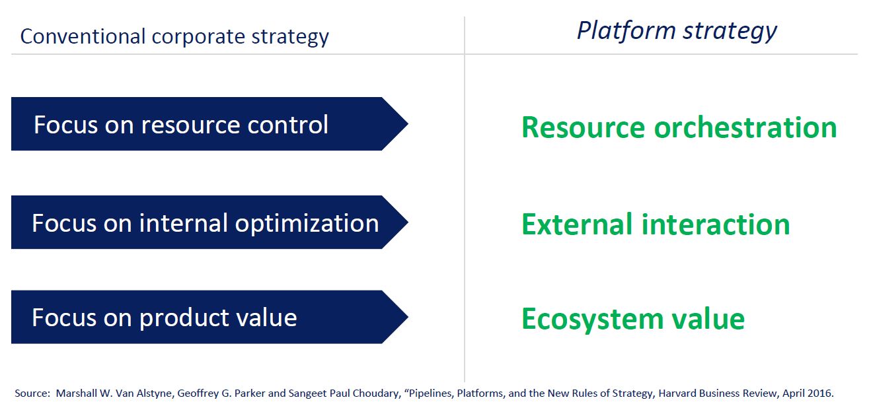
Digitization of decision management processes requires new strategies

Slide 5

Resource orchestration requires
What is happening & why?
What will happen?
What should we do?
Mastering 3 W’s

Slide 6

Culture shift required to master 3 W’s
When did you 1st know?
What was the speed & quality of your actions?

Slide 7
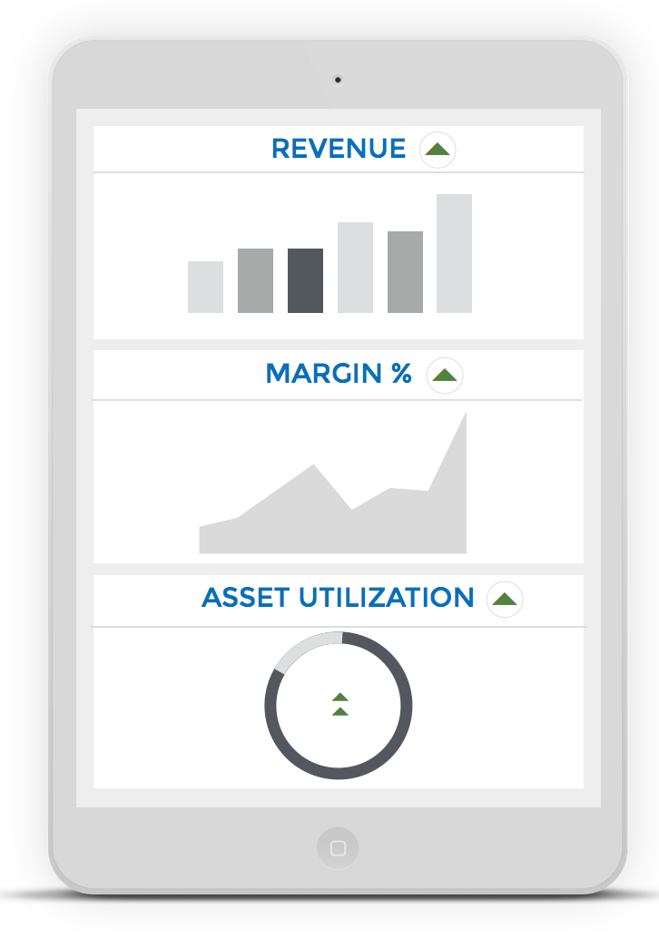
Transforming decision making speed and intelligence is the largest value opportunity across organizations
80 Million $ incremental operating profit
for a 4 Billion $ Revenue Manufacturer
100 Million $ incremental operating profit
for a 10 Billion $ Retailer
150 Million $ incremental operating profit
for a 12 Billion $ Professional Services company

Slide 8









The Problem
Useful knowledge stuck in people’s heads & other silos
Reporting
Increased latency
Lack of visibility
Poor coordination
CRM
ERP
Alignment
Meetings
PLM
SCM

Slide 9

The Solution
An Integrated Cognitive Decision Management Platform
Market Intelligence
Integrated Business Plans
Performance Management
Where each connected plan embodies:
Strategic plans
Assumptions
Statuses
Projections
Pending Actions
Financial plans
Goals
Market size
Sales & operations plans
Competitor
KPIs
Customer
Functional Plans
Sales plans
MarkEting & promotion plans
Product portfolio plans
demand plans
Supply plans
Post-game Analysis
Supplier
Customer plans
Supplier plans

Slide 10
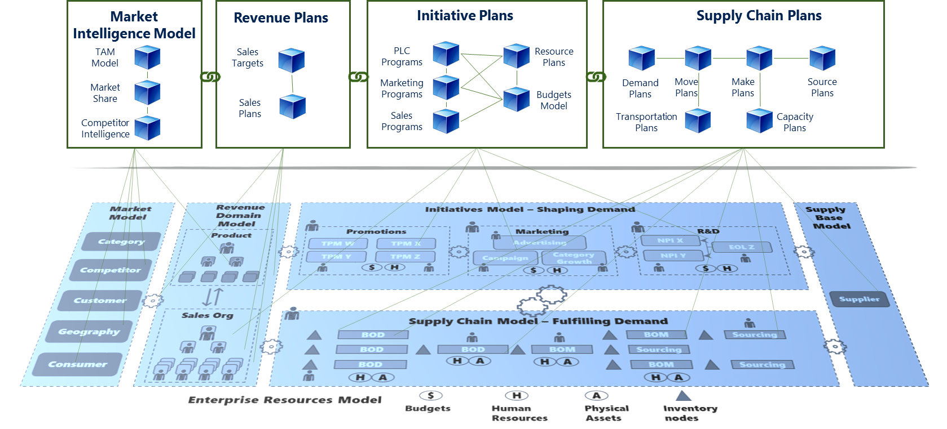
How does Cognitive Decision Management Platform support integrated decision making?
Collaboration Layer
Computation
Model
Knowledge Model
Data Sources Layer
Multi-directional, real-time propagation of risks, opportunities, and plan changes facilitated by AI agents
Faster, collaborative, and smarter decision making with global insight to tradeoffs, and constraints

Slide 11








Characteristics of Cognitive Decision Management Platform
VISIBILITY • ANALYTICS • PLANNING • COLLABORATION • LEARNING
  REAL TIME VISIBILITY TO RISKS & OPPORTUNITIES
            Early detection anywhere in the value chain, real time propagation, collaboration
  TRUSTED FORECASTS
            One source of truth + predictive analytics + assumptions visibility
  IDEAS TO INITIATIVES
            Create, collaborate and convert ideas to proposals to funded initiatives faster
  RAPID SCENARIO PLANNING
            Evaluate financial tradeoffs, resource (budgets, people, supply) constraints
  SYNCHRONIZED PLANS
            Linked models (Product, Sales, Supply Chain) ensuring plans kept in synch
  FAST ALIGNMENT & EXECUTION
            Cutting down cycles from decision to execution through collaboration
  POST GAME ANALYTICS
            Performance vs. Plan analytics to drive accountability & improvement actions
  HIGH ADOPTION SYSTEM
            Simple to use, flexible platform to drive high adoption

