Slide 1


Platform Wars:
The Battle for Developers
Janel Garvin
Evans Data Corporation
340 Soquel Ave.
Santa Cruz, Calif.
www.evansdata.com
@evansdatacorp

Slide 2























Evans Data Corp. – Who We Are
Delivering Market Intelligence with Exclusive Focus on Software Development since 1998
Syndicated Surveys – Global Development, Big Data, Cloud, Mobile, Internet of Things, Tactical Surveys
Global Developer Population and Demographics Study
Custom Research projects – Developer program benchmarking, Feature testing, Segmentation and Personas,
Developer Relations Conference and DevRelate – new online developer program certification site

Slide 3


Emergence of the Worldwide Platform Ecosystem
The world is rapidly becoming more interconnected through the convergence of new technologies including Cloud, Big Data, Internet of Things and Machine Learning.
176 platform companies worldwide with a market valuation of $1 billion US dollars or more*
Thousands of smaller companies are developing and offering APIs to support nascent platforms
Companies MUST offer their services and connect with others through platforms and APIs
*The Rise of the Platform Enterprise: A Global Survey, Peter Evans and Annabelle Gawer, CFGE

Slide 4








API Adoption = Platform Success or Failure
New Dynamics Create New Competitive Forces
Platforms are becoming a critical element of market success
Platforms must be adopted or they will FAIL
Traditional Platforms
Innovation Platforms
Vertical Industry Platforms

Slide 5
APIs and Their Use is Pervasive
Ninety-six percent of developers say their typical application uses APIs
Types of APIs vary according to geography – the newest markets are most accepting of open APIs

Slide 6
Developers Determine Adoption
Factors that are important:
Perceived market share and potential
Traffic management
Notifications of issues
Revenue split or costs
APIs are important to more than 90% of developers across all geographical regions

Slide 7
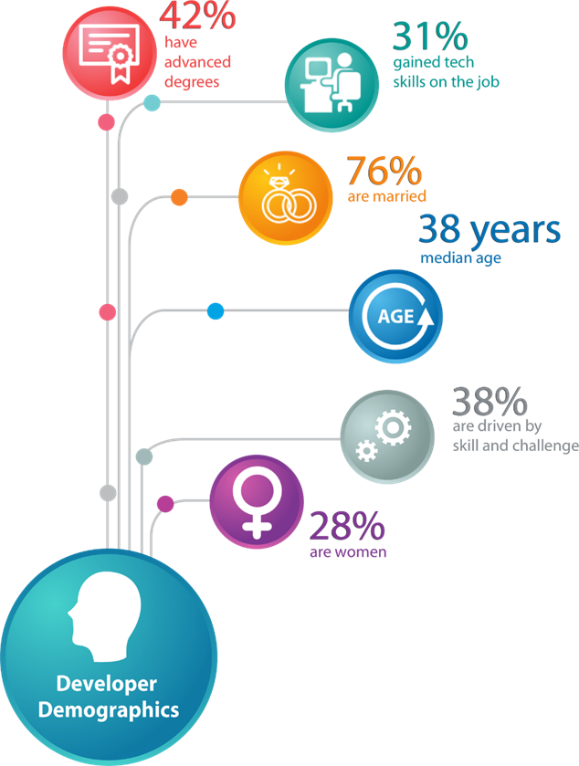
Understanding Who Developers Are

Slide 8

Global Developer Population 2016
North America
4,406,000
APAC
7,471,500
EMEA
7,222,500
Latin America
1,907,600
Over 21 million professional developers are
distributed around the globe in 2016

Slide 9
Global Developer Population 2021
15%
27%
North America
5,062,300
20%
APAC
9,488,800
EMEA
8,656,900
20%
Latin America
2,296,800
Global developer population projected to be 25M in 2021

Slide 10
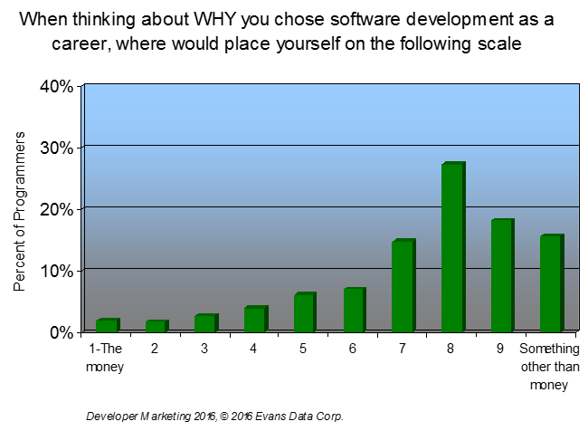
Developer Psychographics
The most important drivers for development work:
Building skills and meeting a challenge
Curiosity
Establishing a reputation
Open source software is a fait accompli throughout all types of development

Slide 11
Mobile and Cloud Development
52% of developers overall report they are presently developing some mobile apps
Cost and flexibility are the top reasons to move to the Cloud
Notes:
11

Slide 12
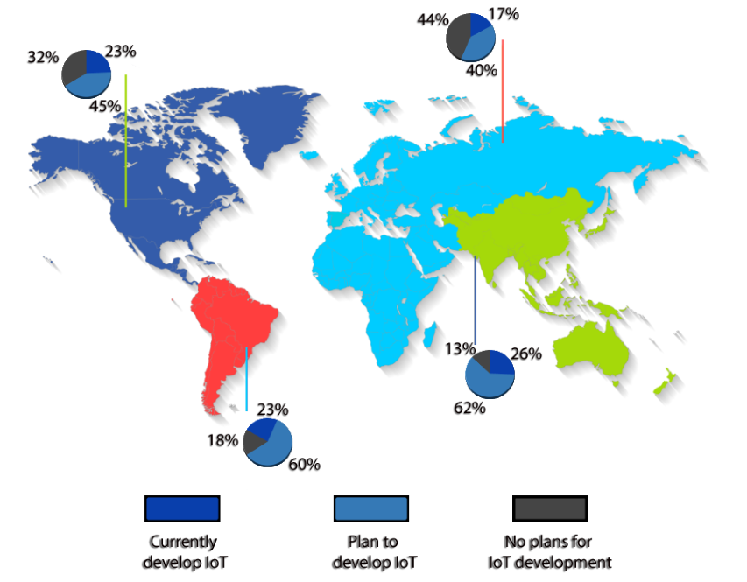
Global Distribution of Internet of Things
APAC and North American developers are the most likely to currently engage in IoT projects.
APAC developers are more likely to have IoT in their plans.

Slide 13
Hot IoT Targets
Internet of Things Survey Series, © 2015 Evans Data Corp.
Among developers working on IoT, industrial devices are the most targeted types of platforms

Slide 14
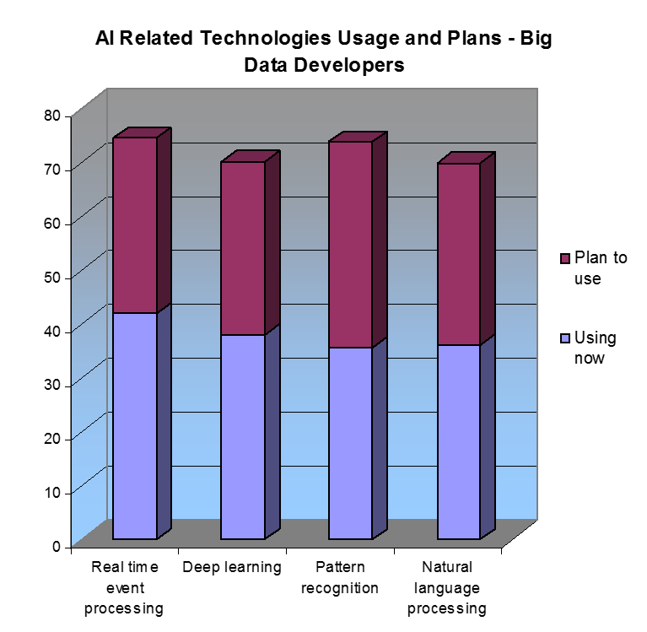
AI and Deep Learning
Notes:
From Developer Marketing 2016

Slide 15
Industrial Developers
Industrial developers are older and the companies they work for are older too as well as larger
While less likely to be currently involved in Big Data projects they are much more likely to be planning to work with Big Data soon
While slightly less likely to be working on mobile or Cloud deployed apps, they are more likely to be working on IoT
Industrial developers use C++ more often and use scripting languages less
Notes:
Are both of these sections about industrial developers?

Slide 16
Reasons to Choose a Platform
It is important that platforms have a vibrant community that can support developers
Developers also value companies’ investment in providing great development tools

Slide 17
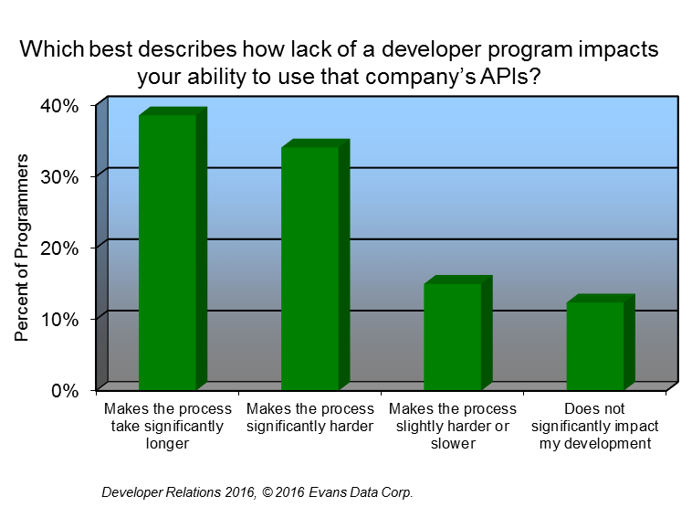
Developers Want Programs to Support APIs
Two-thirds of developers ONLY access APIs that are supported by a program
Lack of a program is a big drag on developer efficiency and productivity

Slide 18
Developer Program Membership
Developer program membership has grown steadily over the years
Membership is often tiered to attract the most developers and offer top developers added support
IoT and mobile developers are more likely than PC and cloud counterparts to join developer programs

Slide 19
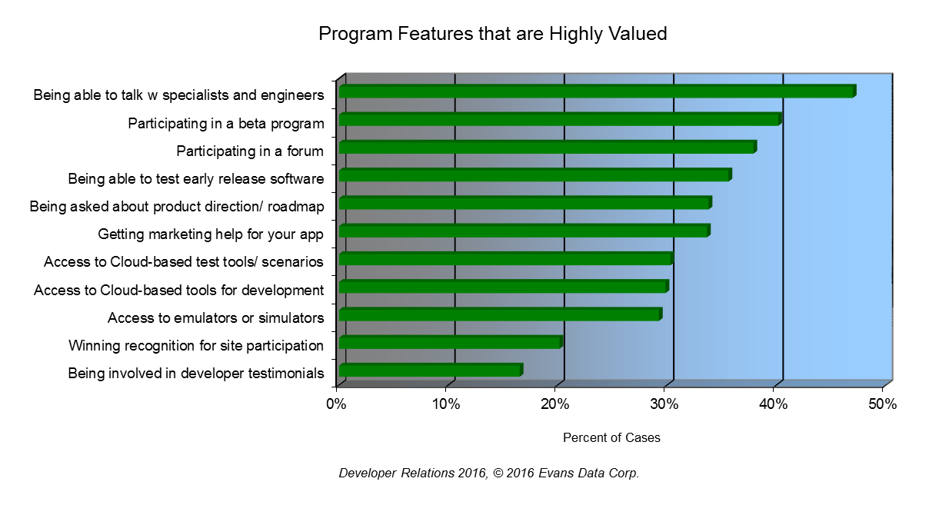
Top Reasons to Join a Program
The need for technical information and tech support lead developers to join programs
Making the developer feel like a partner involves more in-depth forms of communication and participation

Slide 20
Trusted Sources

Slide 21
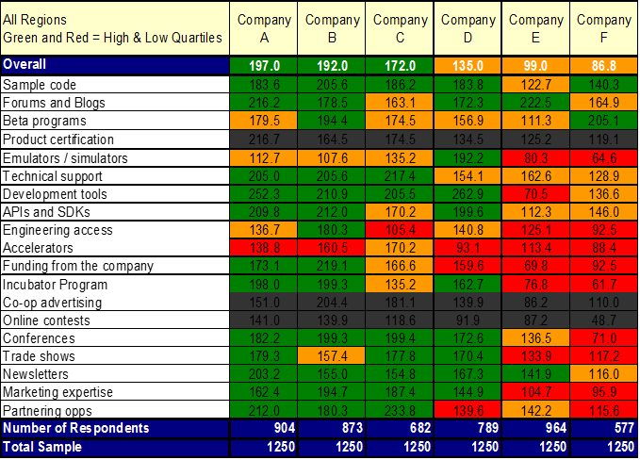
Create a Loyal Community
Developer Relations Programs 2016 © 2016 Evans Data Corp.
Providing engineer access is expensive, but it’s one of the most powerful things you can do

Slide 22








Accelerators, Incubators, Coding Contests
Outsourced
Partners
New Vendors
Internal
Main Platform Vendors

Slide 23
Perceptions of Next Gen Tech Solutions
Developers expect that the companies that have traditionally offered products in the software or operating system space will drive innovation for the next generation of technology solutions

Slide 24
Public Platforms Targeted
Developers were asked about plans for 25 platforms from public companies
The top sixteen platforms are displayed here

Slide 25
Private Platforms Targeted
Developers were asked about plans for 25 platforms from private companies
Commercial companies dominate – Overall private companies lag behind public ones in developer recruitment

Slide 26
Attraction vs Specificity
Low
Google
Microsoft
Ignition
IBM
Facebook
Specificity of focus
Apple
GE
Siemens
General Motors
Oracle
Intel
Cisco
Visa
AT&T
Nike
Ford
Monsanto
John Deere
High
Hard
Ease of attracting developers
Easy

Slide 27
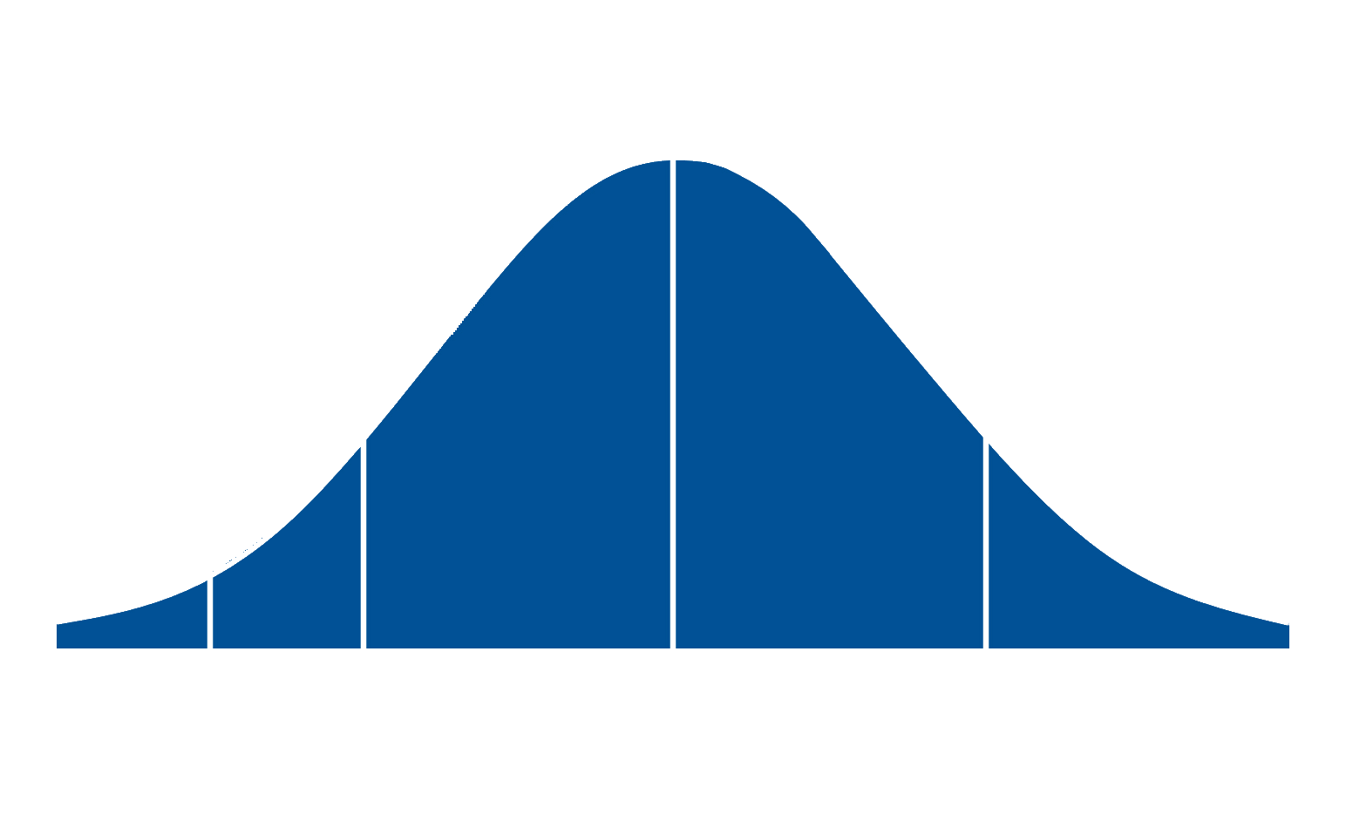
Getting Developers OnBoard
Regardless of your platform you must get developers to adopt it
IoT
Machine Learning
AgriBusiness
AR/VR
Industrial
Fin-tech
Robotics
Wearables
Innovators
Early
Adopters
Early Majority
Late Majority
Laggards

Slide 28

Evans Data Corp
Primary, demand side research
Founded in 1998
In-depth experience with developers
Experts in analyzing tech trends
www.evansdata.com
800.831.3080

Slide 29
About Evans Data Corp
Evans Data Corp provides market research for the development community. Our goal is to represent the views, attitudes, desires and opinions of the community of developers to those companies who create devices, tools, operating environments and other systems that developers use. We strive to help our clients be as successful as possible and to make the right choices regarding strategic direction and tactical product marketing. EDC offers three primary services including Multi-Client Surveys, Custom Surveys, and Targeted Analytics.
Publication rights to any of the results of Evans Data’s surveys or the data presented in this presentation are not granted to anyone without expressed written consent of Evans Data.
For more information call Evans Data Corporation at 800-831-3080, or visit our Web site at www.evansdata.com.
Evans Data Corp. (EDC) has made every effort to produce the highest quality research product in this series. The customer understands that EDC uses those statistical and data gathering techniques which, in its opinion, are the most accurate possible. However, inherent in any statistical inquiry is a possibility of error, which must be taken into account in evaluating the results. Evaluations and interpretations of statistical research findings and decisions based on them are solely the responsibility of the customer and not EDC. The conclusions, summaries and interpretations provided by EDC are based strictly on the analysis of the data gathered and are not to be construed as recommendations; therefore EDC neither warrants their viability or accuracy nor assumes responsibility for the success or failure of any customer actions subsequently taken.
Notes:
29

