Slide 1

MIT PLATFORM STRATEGY SUMMIT
2014

Slide 2


What's the Future of Business?
Brian Solis
Principal Analyst, Altimeter Group

Slide 3
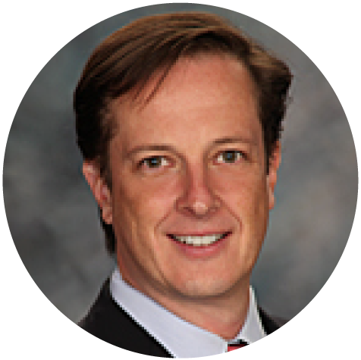


Panel:
Energy’s Digital Revolution: Emerging Platform Leaders
Peter Evans
Mike Kaplan
Eric Graham
Vice President,
Center for Global Enterprise
Vice President Marketing,
Retroficiency
Co-founder & CEO,
CrowdComfort

Slide 4
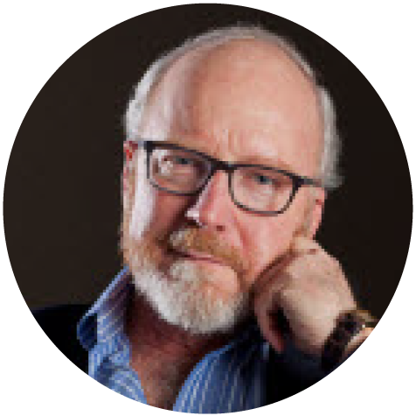
Platform Pull
John Hagel
Co-chairman, Deloitte LLP Center for the Edge

Slide 5

Education Platforms
Jose Fuentes
Co-founder, Duolingo

Slide 6

Publishing Platforms
Eileen Gittins
Founder, President and CEO, Blurb

Slide 7


Fireside Chat: The Investing Ecosystem
Rich Miner
Jeff Jarvis
Co-founder, Android
Journalist and Media Expert

Slide 8

Jawbone Platform
Andrew Rosenthal
Group Manager: Wellness + Platform, Jawbone

Slide 9

On-line Staffing Platforms Go Global
Stephane Kasriel
SVP Product and Engineering, Elance-oDesk

Slide 10

Markets & Platforms
Peter Coffee
VP Strategic Research, Salesforce

Slide 11

Building Communites on Gaming Platforms
Songyee Yoon
Chief Strategy Officer, NCSoft

Slide 12

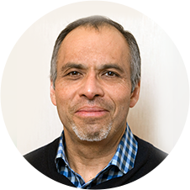


Panel – Winning!
Platform Strategies in the Digital Games Industry
David Nieborg
Mark Coleman
Joost van Dreunen
Walter Somol
Postdoctoral Fellow,
University of Amsterdam and
Massachusetts
Institute of Technology
Director, Digital Analytics,
Turbine/WB Games
Founder and CEO,
SuperData Research,
Adjunct Professor,
New York Unversity
VP, Publishing, Harmonix
Music Systems

Slide 13

How Will Big Data & Cloud Computing Change Platform Thinking?
Ming Zeng
Chief Strategy Officer, Alibaba

Slide 14
MIT PLATFORM STRATEGY SUMMIT
2014

